Slide 1
lab3_SOC實踐中斷

Slide 2
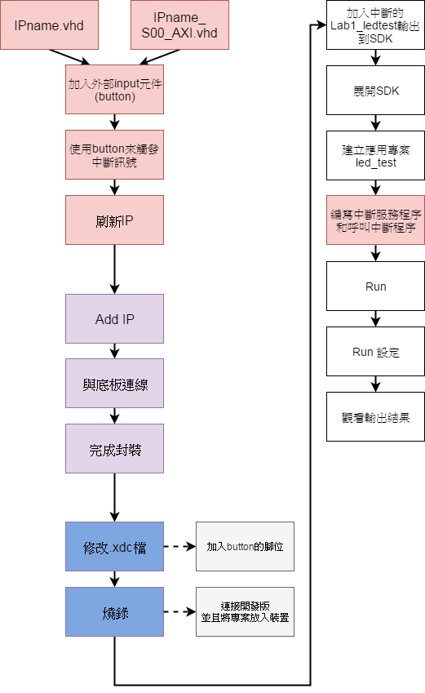

Slide 3
IPname.vhd

Slide 4
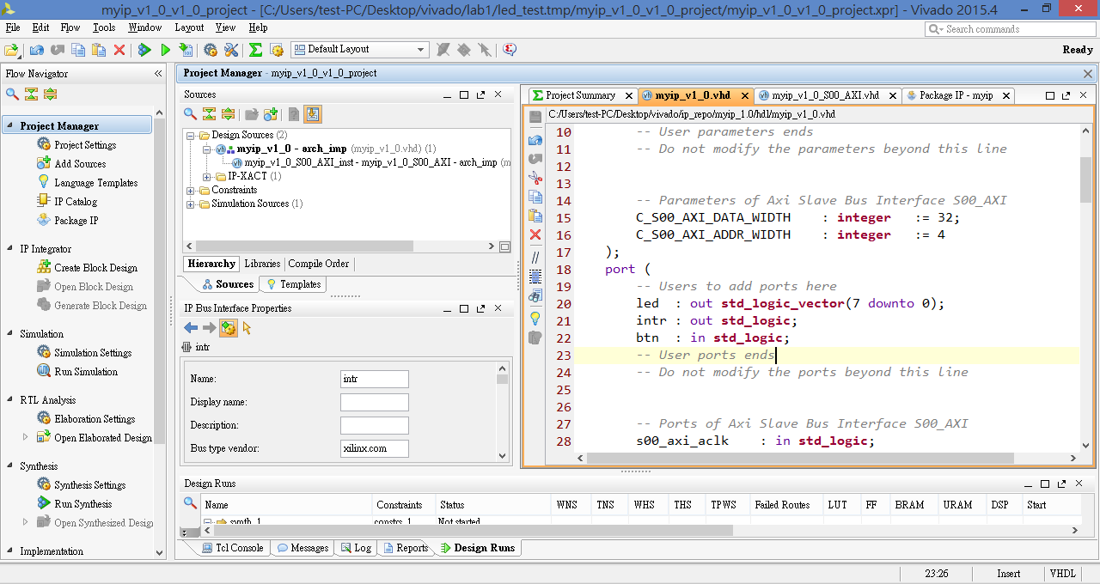

Slide 5
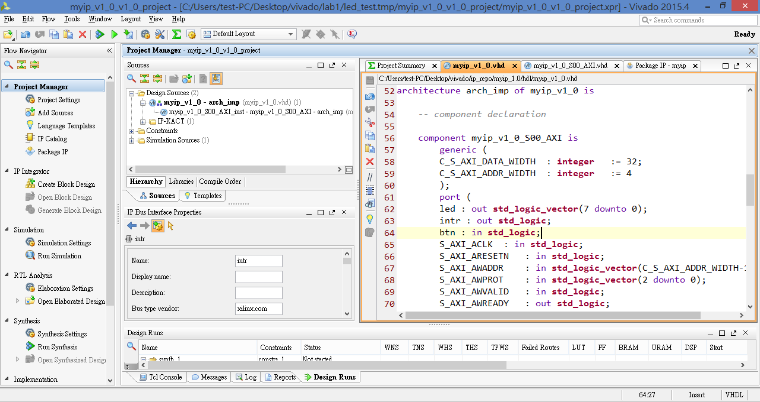

Slide 6
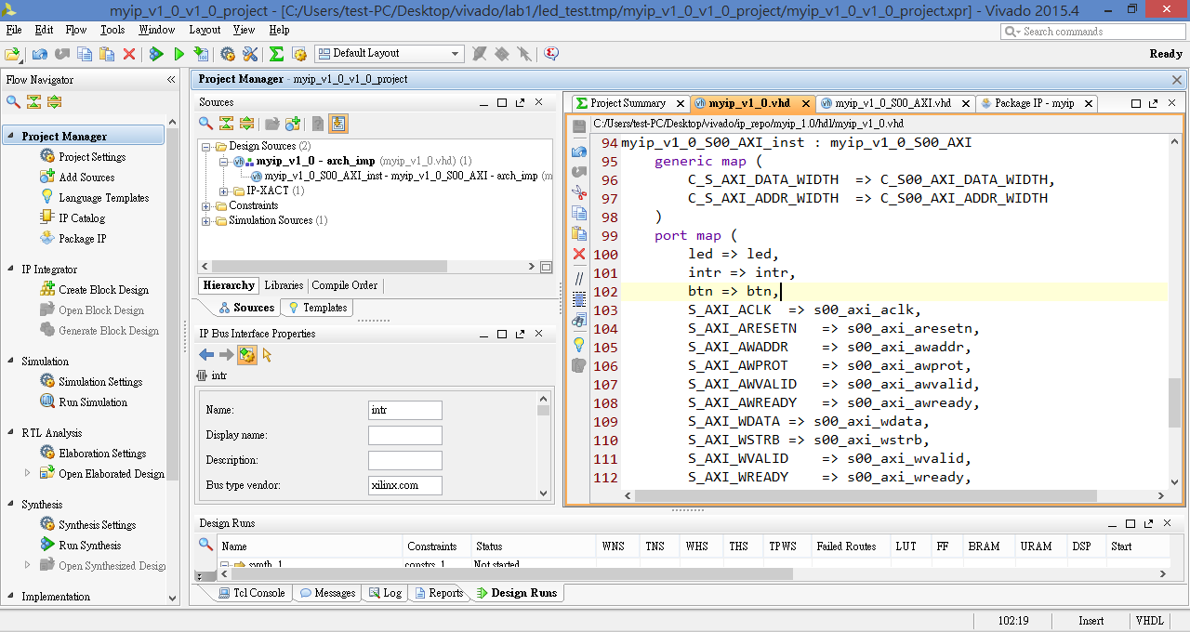

Slide 7
IPname_S00_AXI.vhd

Slide 8
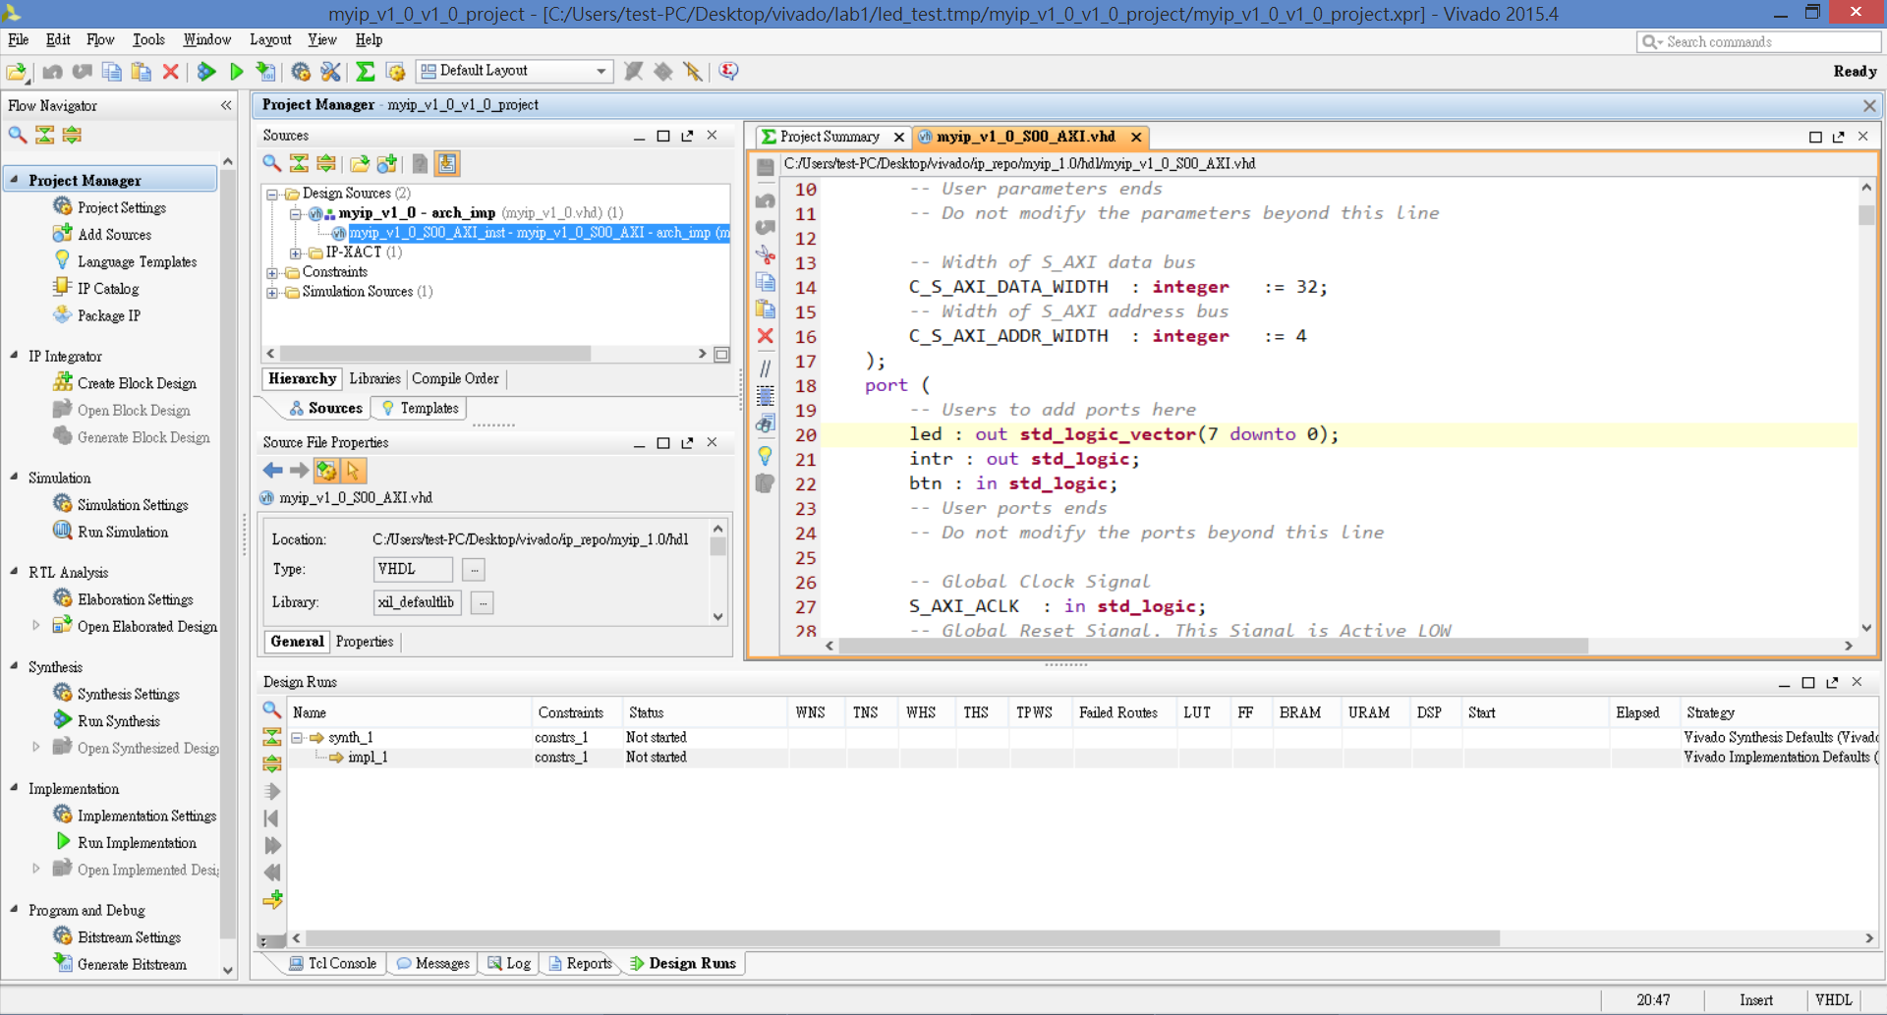

Slide 9
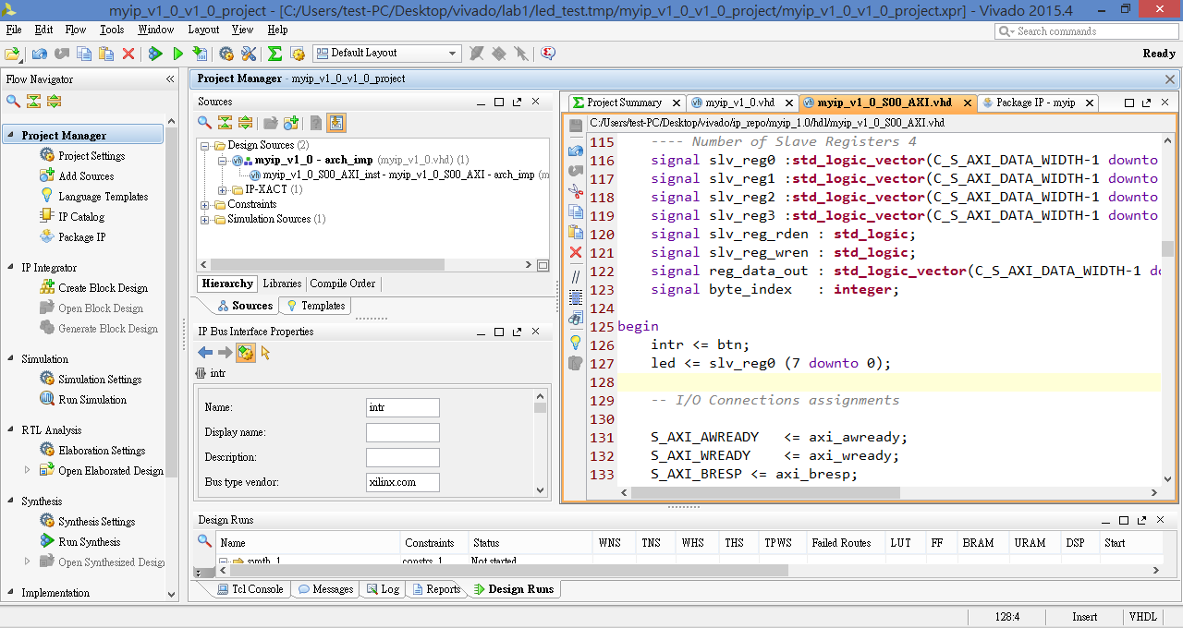

Slide 10
設定IP之中斷訊號輸出腳位

Slide 11
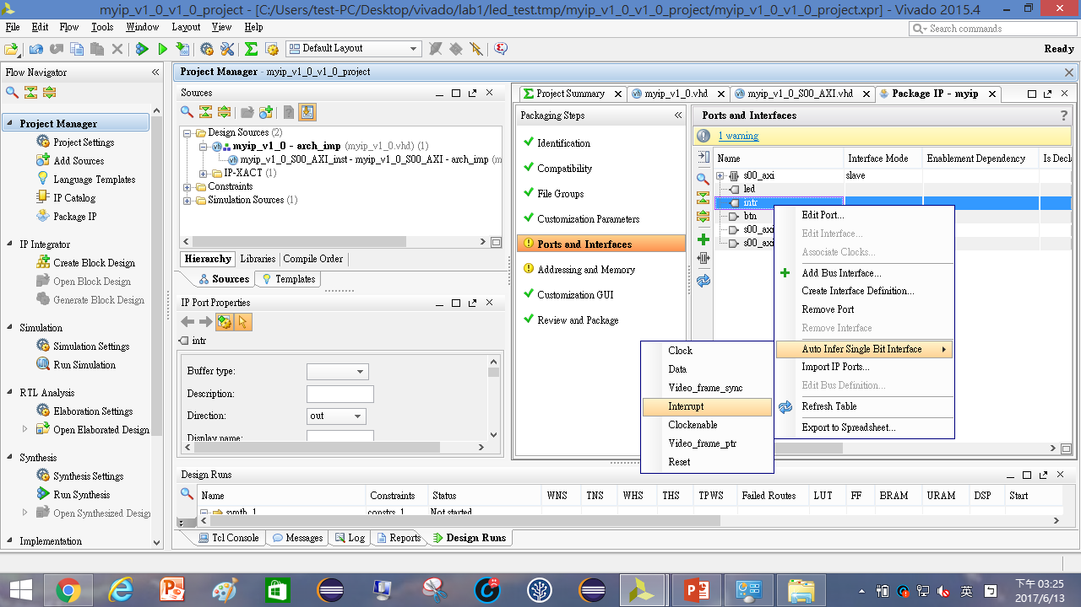

Slide 12
刷新IP

Slide 13
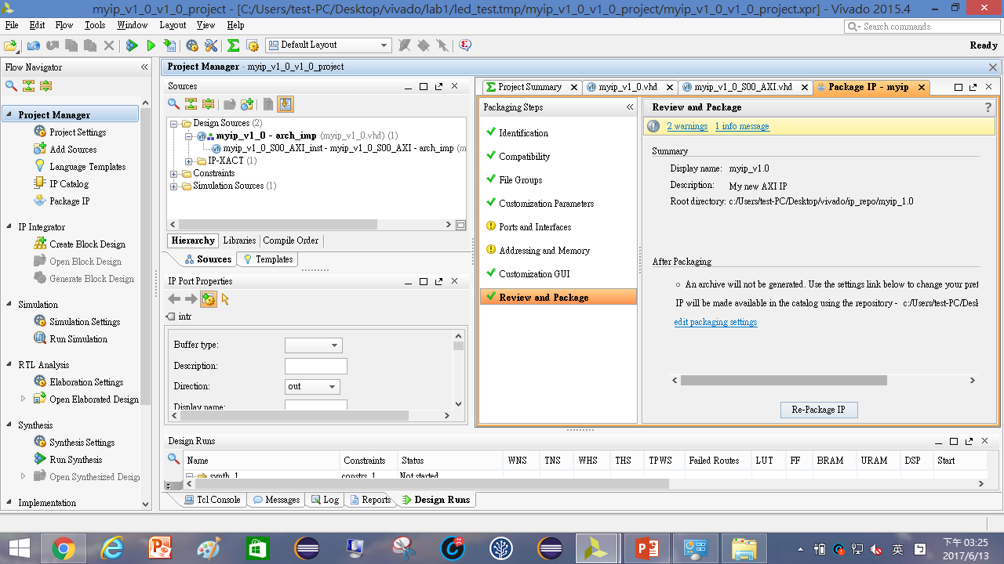

Slide 14
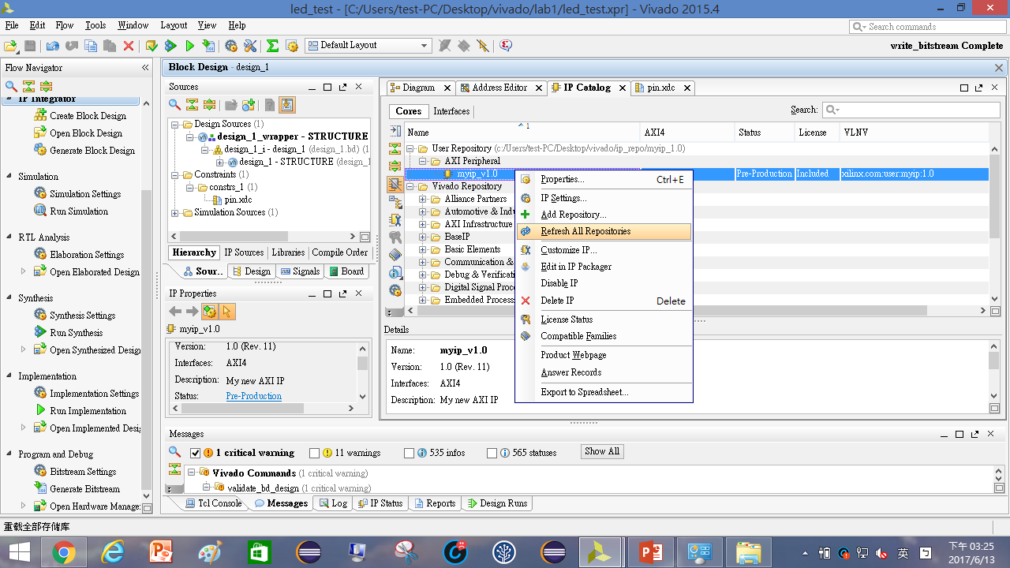

Slide 15
重新佈線

Slide 16
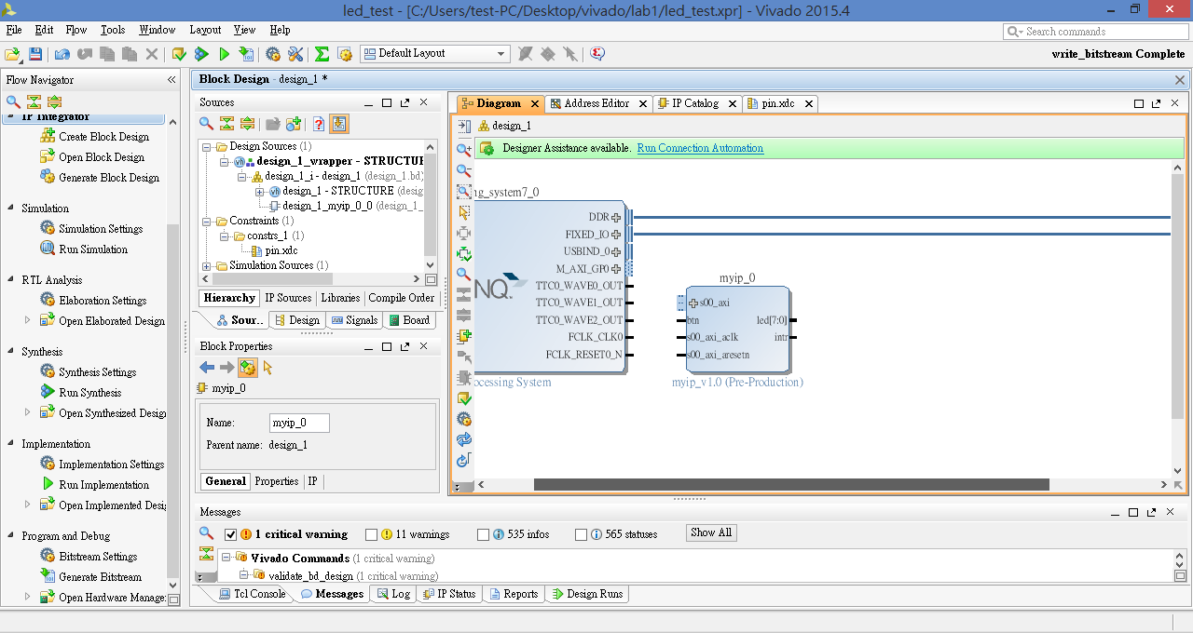
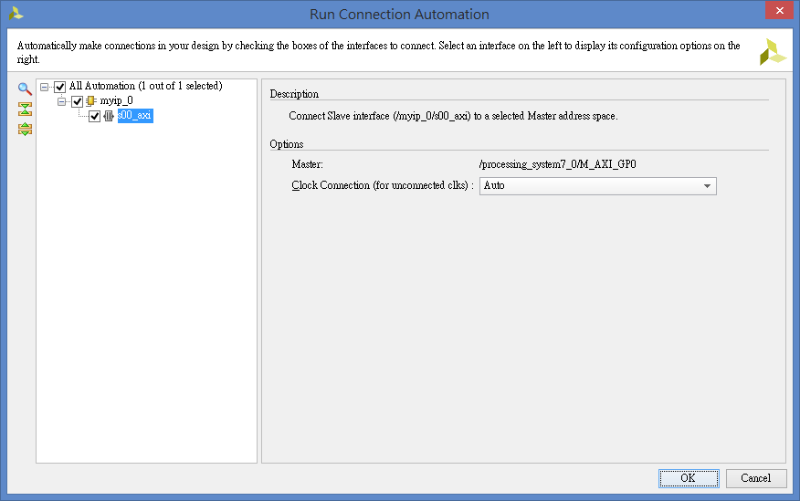

Slide 17
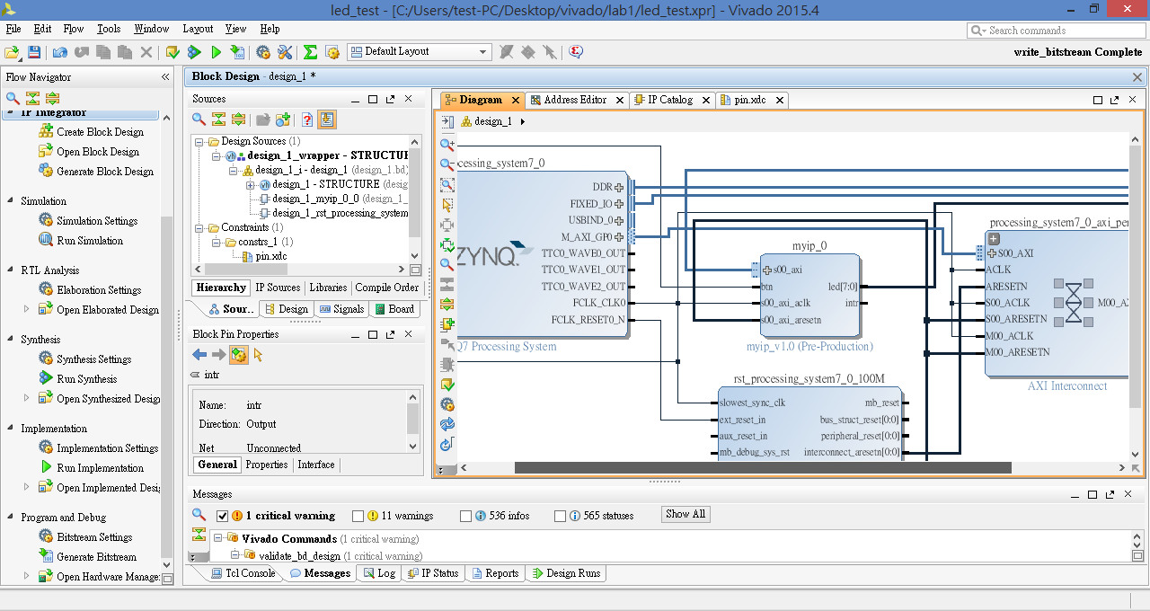

Slide 18
定義底板中斷輸入腳位

Slide 19
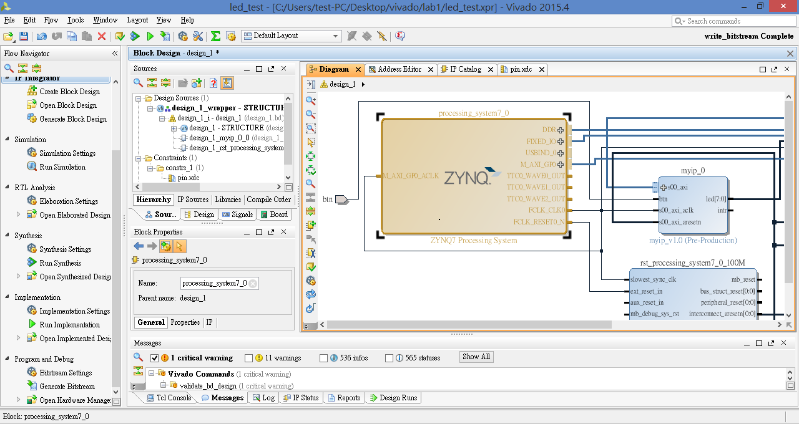

Slide 20
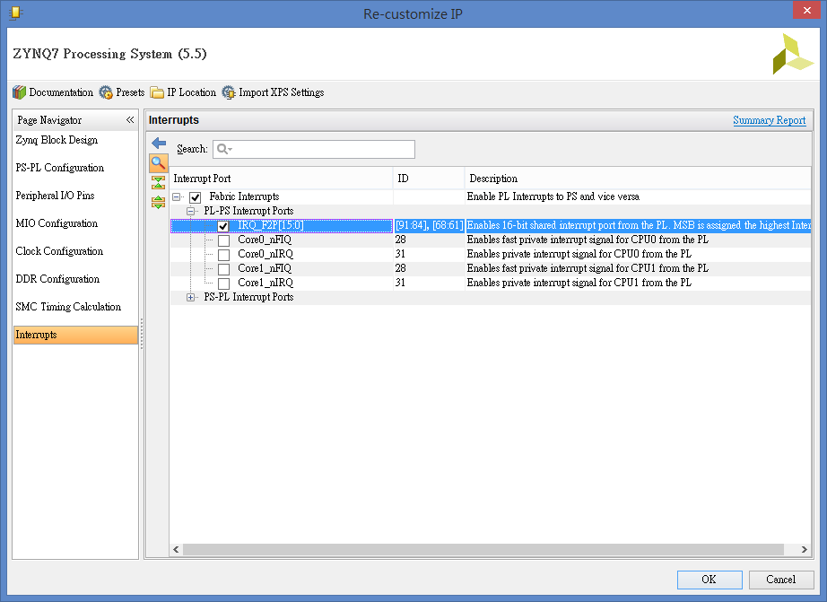

Slide 21
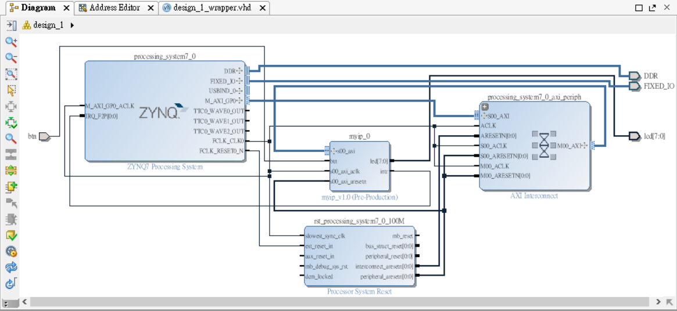

Slide 22
完成封裝

Slide 23
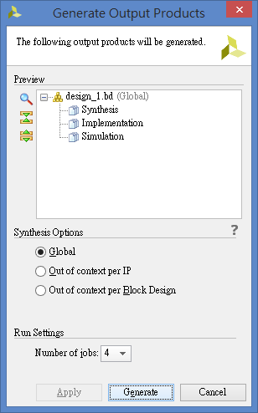
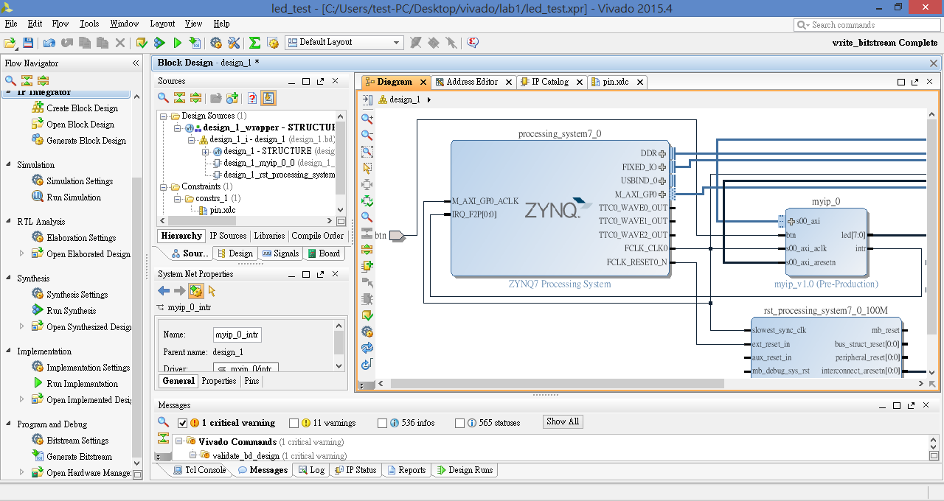
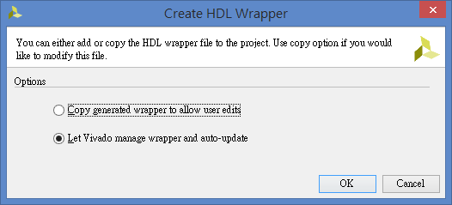
右鍵

Slide 24
修改.xdc檔

Slide 25
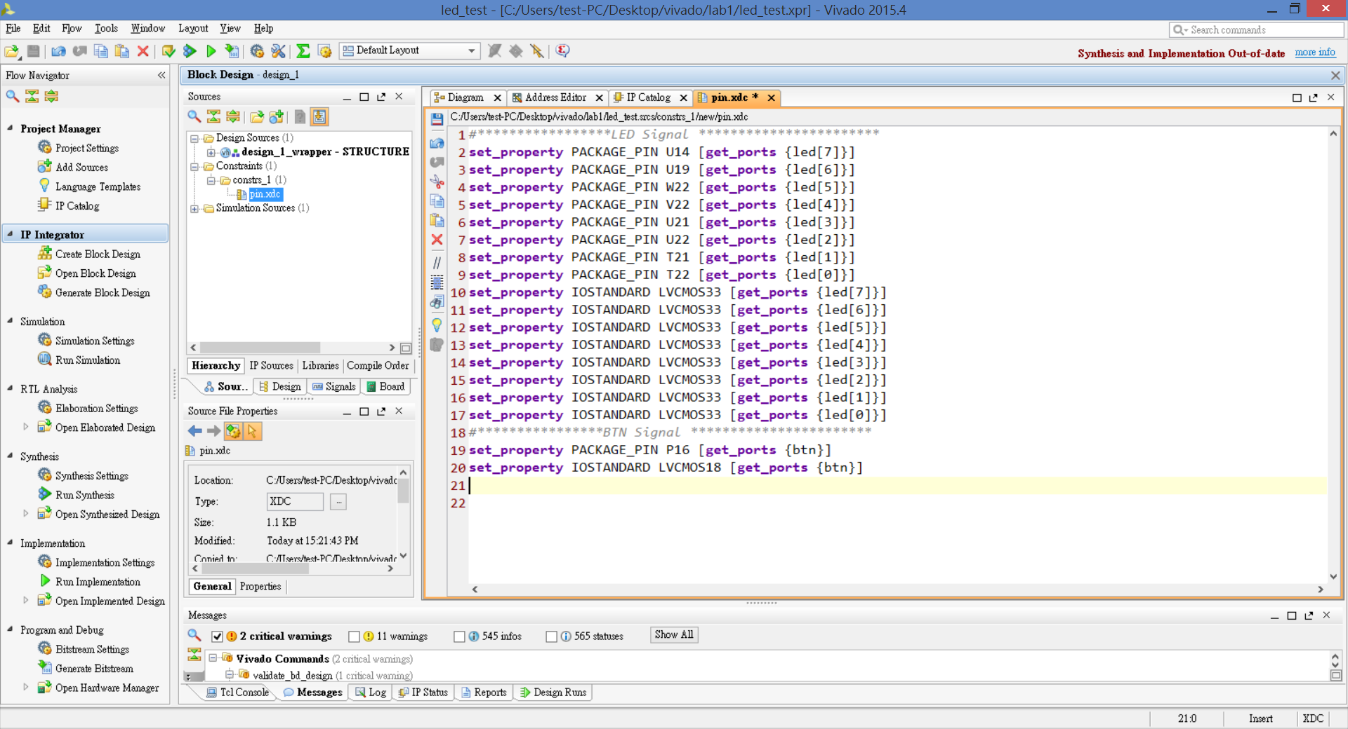

Slide 26
加入中斷的Lab1_ledtest輸出到SDK

Slide 27
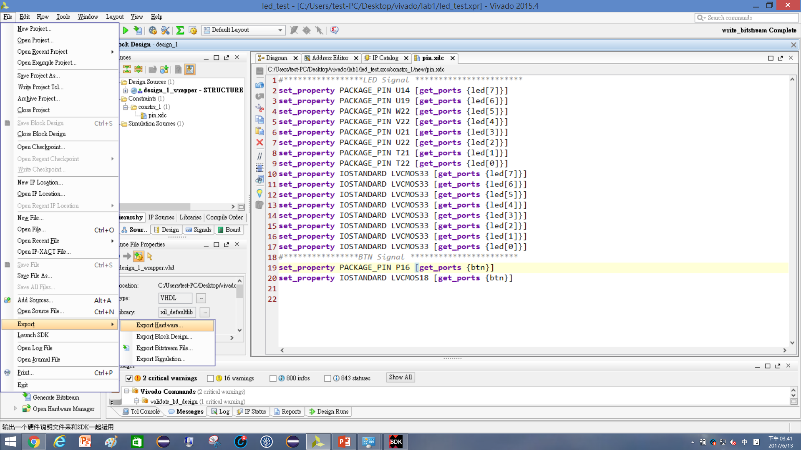


Slide 28
展開SDK

Slide 29
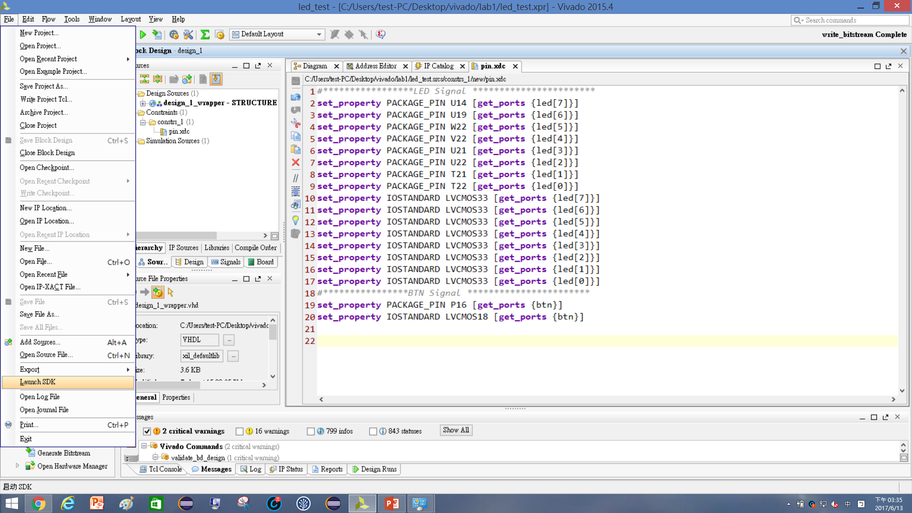


Slide 30
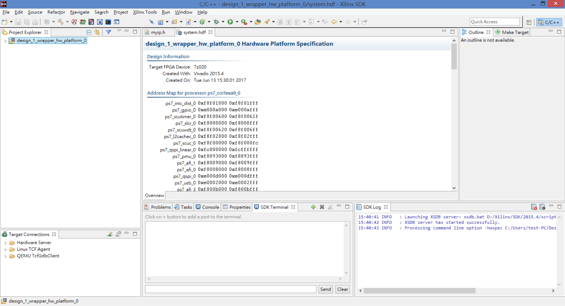

Slide 31
建立應用專案led_intr

Slide 32
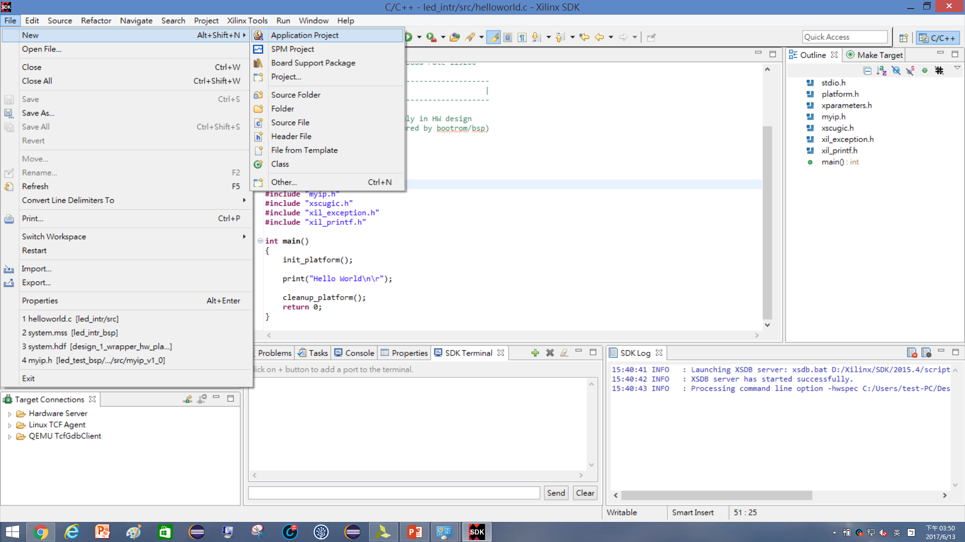
2

Slide 33
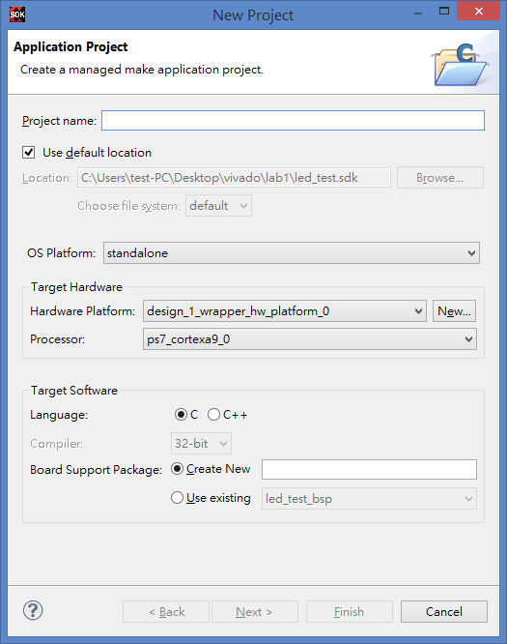

Slide 34
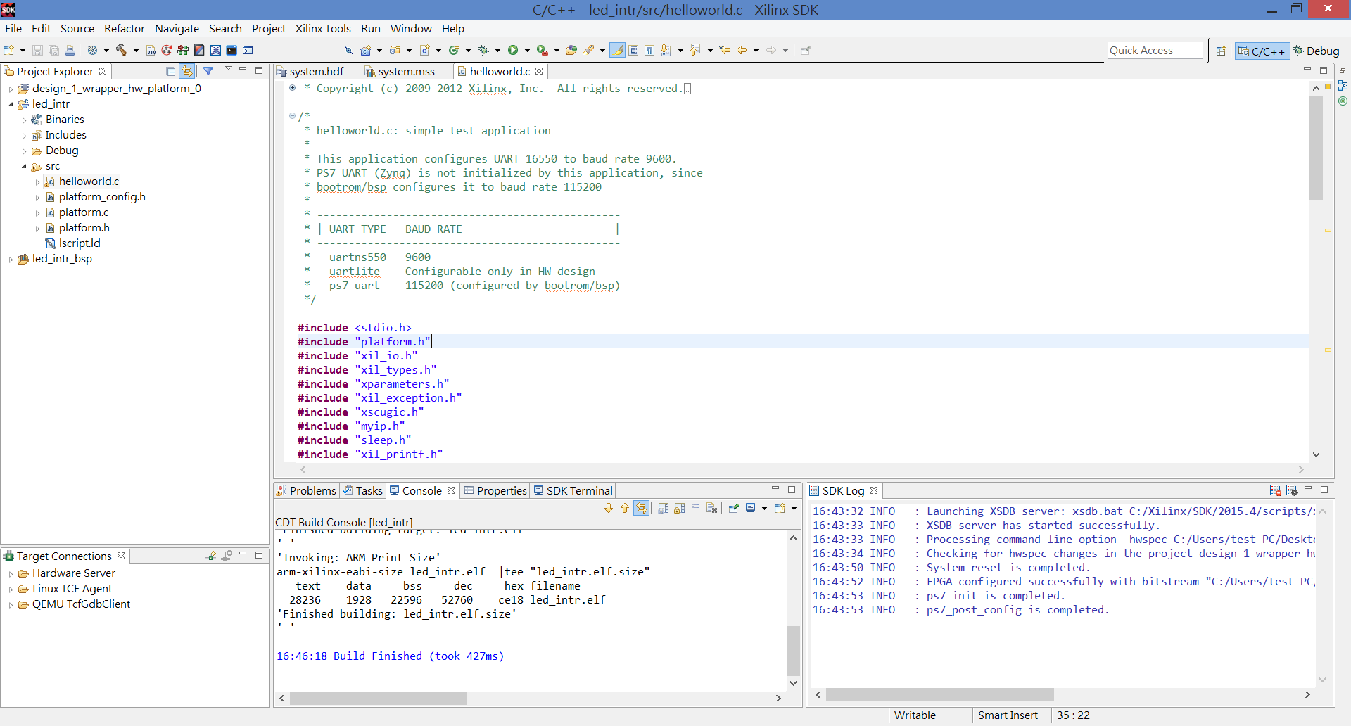

Slide 35
編寫中斷服務程式—原始碼

Slide 36
1.函式庫
#include <stdio.h>
#include "platform.h"
#include "xil_io.h"
#include "xil_types.h"
#include "xparameters.h"
#include "xil_exception.h"
#include "xscugic.h"
#include "myip.h"
#include "sleep.h"
#include "xil_printf.h"
3. interrupt handler
void INTERRUPT_Handler0(void *baseaddr_p){
int i;
xil_printf("Push Button was pressed\r\n");
}
4.中斷初始化
int ScuGicInterrupt_Init(void)
{
int Status;
Xil_ExceptionInit();
GicConfig = XScuGic_LookupConfig(XPAR_PS7_SCUGIC_0_DEVICE_ID);
if (NULL == GicConfig){
return XST_FAILURE;
}
Status = XScuGic_CfgInitialize(&InterruptController,GicConfig,GicConfig->CpuBaseAddress);
if (Status != XST_SUCCESS){
return XST_FAILURE;
}
Xil_ExceptionRegisterHandler(XIL_EXCEPTION_ID_IRQ_INT,(Xil_ExceptionHandler)XScuGic_InterruptHandler,(void *) &InterruptController);
Status = XScuGic_Connect(&InterruptController,XPAR_FABRIC_MYIP_0_INTR_INTR,(Xil_ExceptionHandler)INTERRUPT_Handler0,(void *)&InterruptController);
XScuGic_Enable(&InterruptController, XPAR_FABRIC_MYIP_0_INTR_INTR);
Xil_ExceptionEnable();
XScuGic_SetPriorityTriggerType(&InterruptController, XPAR_FABRIC_MYIP_0_INTR_INTR,0xa0,3);
if (Status != XST_SUCCESS)
return XST_FAILURE;
}
2.變數宣告
XScuGic InterruptController;
static XScuGic_Config *GicConfig;
5.Main
int main()
{
int xstatus;
int i=0;
// interrupt test
xstatus = ScuGicInterrupt_Init();
if (xstatus != XST_SUCCESS)
return XST_FAILURE;
//Wait For interrupt
init_platform();
while(1){
for (i=0;i<=255;i++){
xil_printf("i = %d\n\r",i);
MYIP_mWriteReg(0x43C00000, MYIP_S00_AXI_SLV_REG0_OFFSET, i);
sleep(1);
}
}
//xil_printf("Hello World\n\r");
return 0;
}

Slide 37
編寫中斷服務程式—offset address

Slide 38
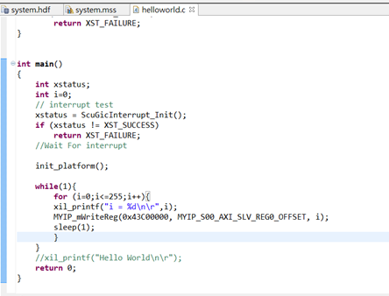
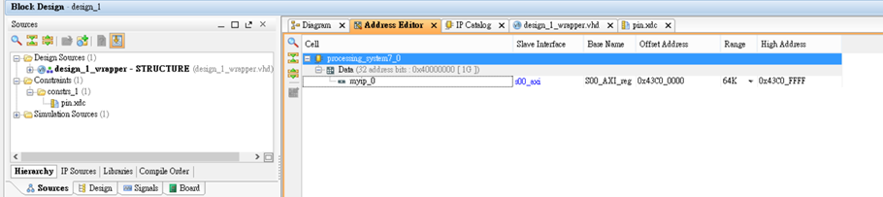
觀看IP的中斷腳位

Slide 39
Run

Slide 40
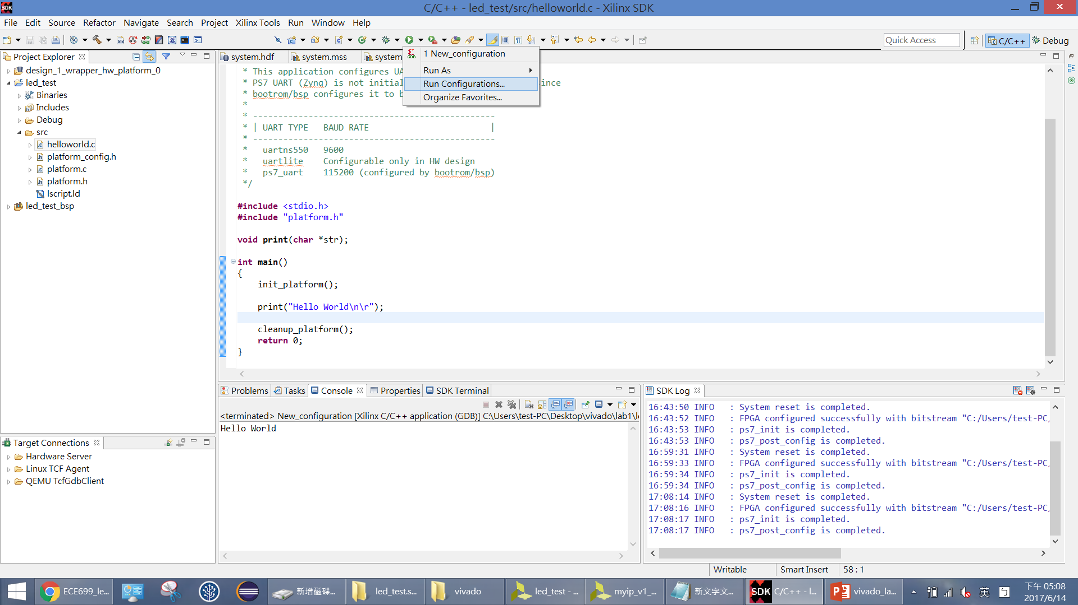

Slide 41
Run設定

Slide 42
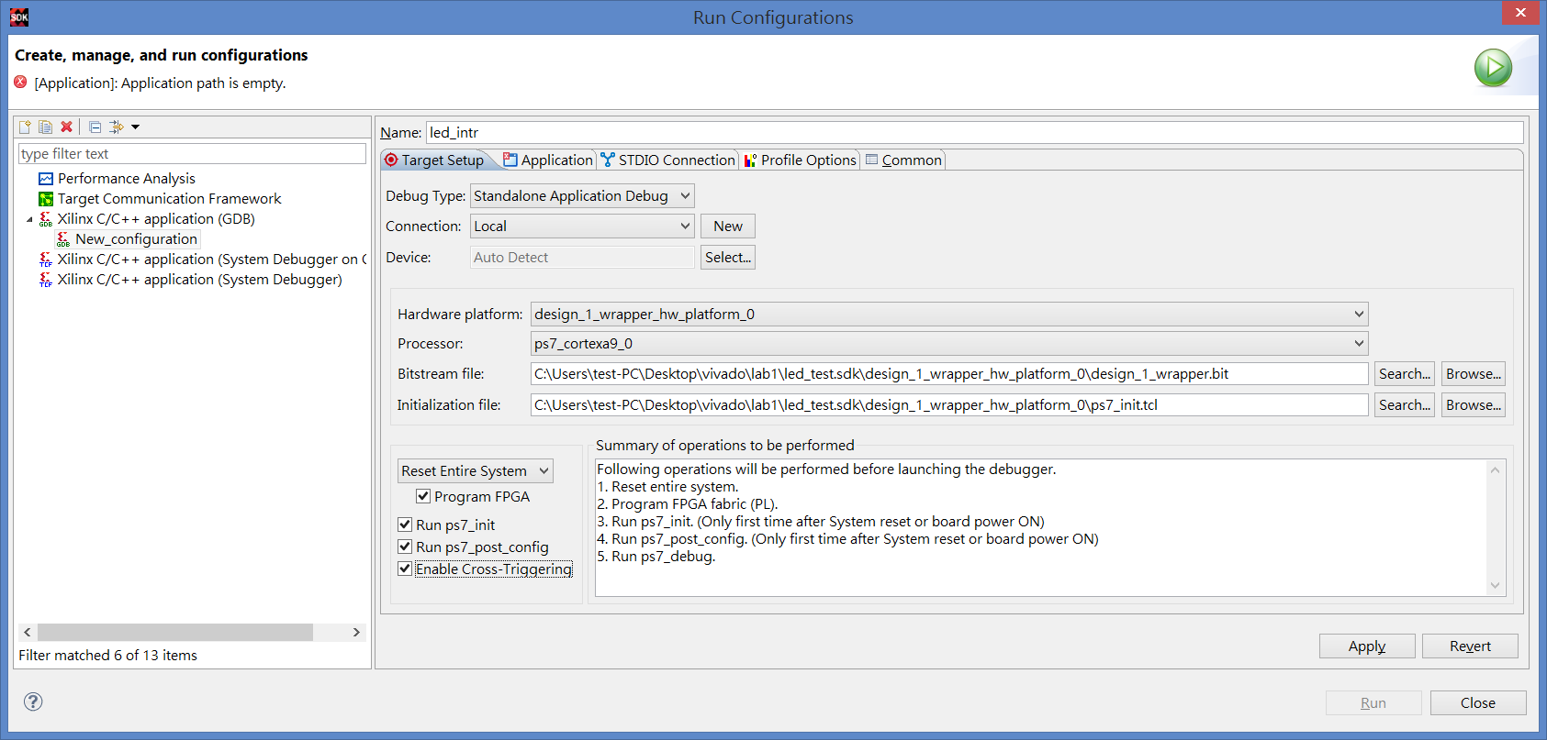

Slide 43
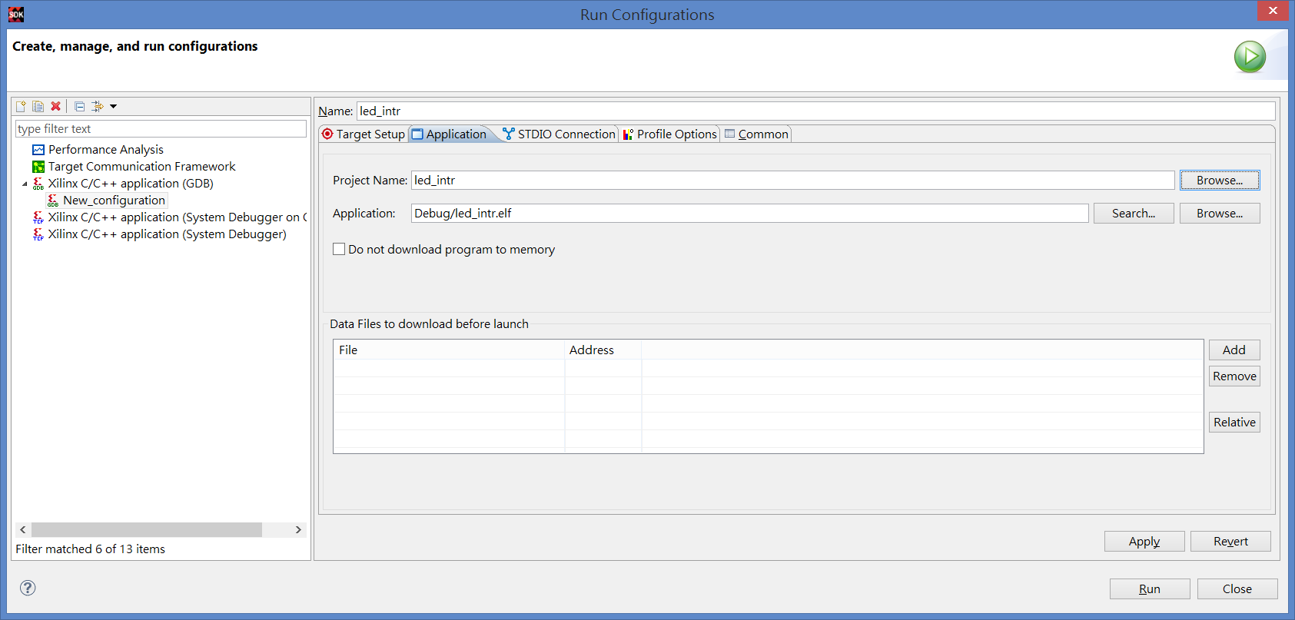

Slide 44
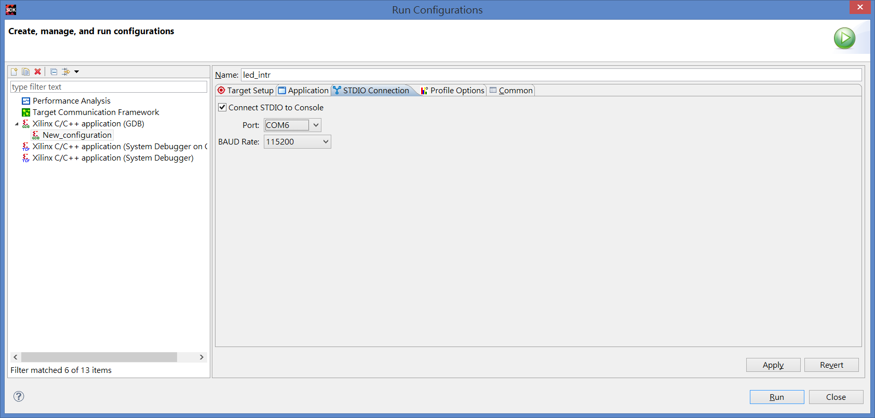

Slide 45
觀看輸出結果

Slide 46
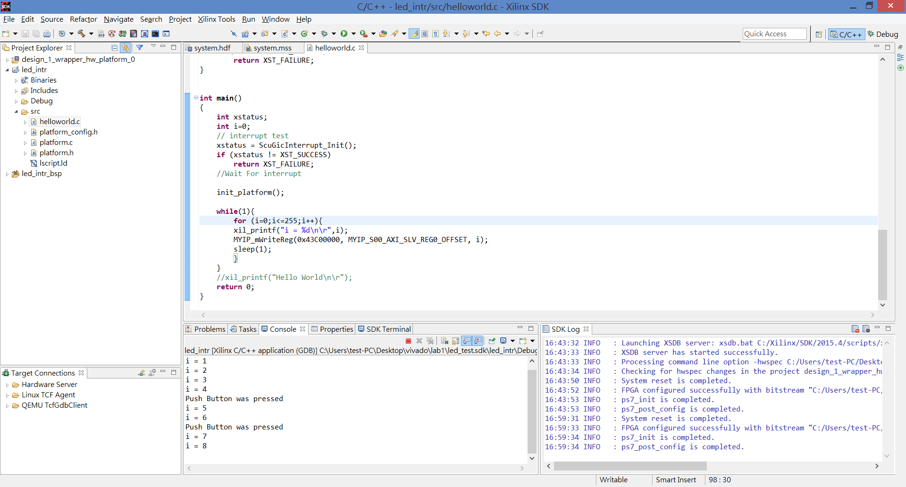
0

